Slide 1
Productivity Analysis of Employees in Textile Industry
Group - 11
Rohitashwa Chakraborty
Divyansh Karki
Safiuddin Mohammed
Yen Wen Ting

Slide 2
Textile Industry?
Provides much needed jobs in rural areas.
Employs 1.7 million people worldwide.
Manufacturing end is distributed into 2 major sectors:
Sewing , Embroidery, Printing
Finishing , Quality Check
It’s workers are its greatest assets.

Slide 3
Project Goal
To determine patterns in the internal working of this garment factory and identify key factors that lead to high productivity amongst its teams.

Slide 4
Project Description
This dataset includes important attributes of the garment manufacturing process and the productivity of the employees.
Incentives provided,
Domain of Work,
Team Size,
Complexity of Work
To answer key questions like what attributes differentiate a productive team from a less productive team.
Monetary incentive the primary motivator towards productivity?
Is there an optimum team size?
Do complicated tasks increase overall team productivity or result in decline of team productivity.
Is the trend alike across the Sewing domain and Finishing Domain?

Slide 5
Table of Contents
Exploratory Data Analysis
Model Results
Insights and Recommendations

Slide 6
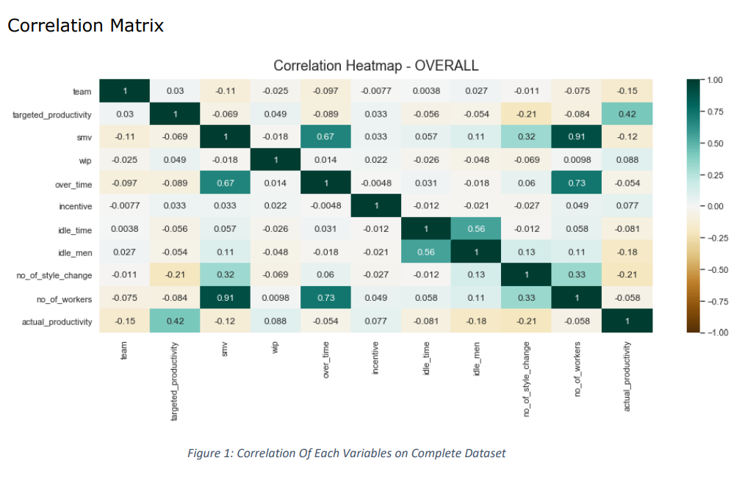
Exploratory Data Analysis
Investigating the relationships among the variables, we observed a high correlation between task complexity, number of workers, overtime, idle time and idle men

Slide 7
Exploratory Data Analysis
The factory includes two departments: Finishing and Sewing. Each department consists of 12 teams of varying size and workload. The investigation is summarized in two fragments:
1
Department level investigation
2
Overall Factory level investigation

Slide 8
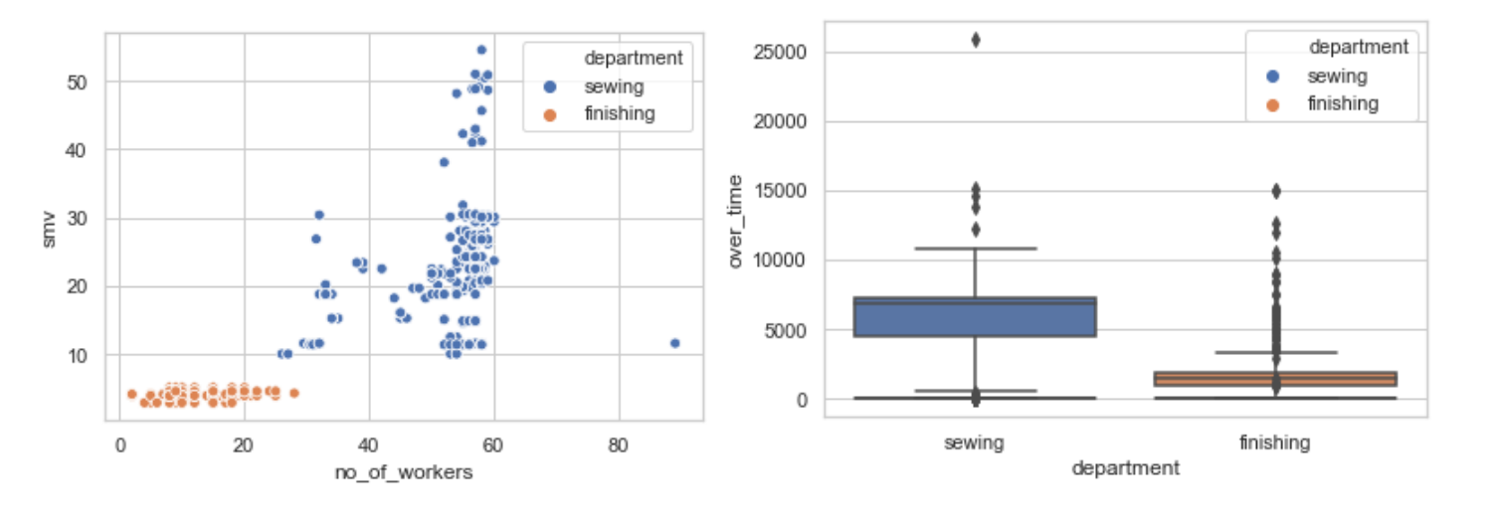
Department Level Analysis
The two departments, Sewing and Finishing have significant disparity in terms of nature of work. There exists large difference in the skill and complexity of the tasks

Slide 9
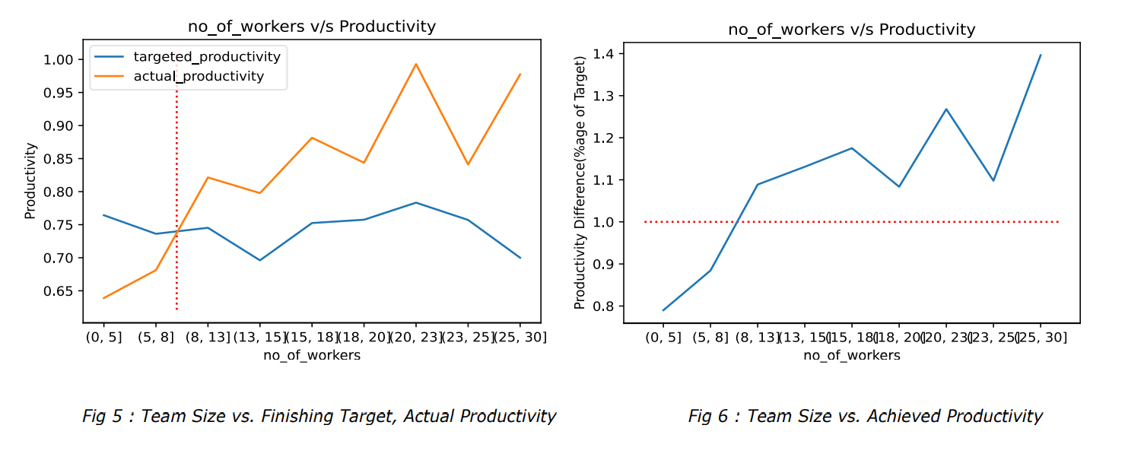
Optimum Team Size - Finishing
The Finishing department favors large teams. Teams with 20-23 members achieve 130% of targeted productivity.

Slide 10
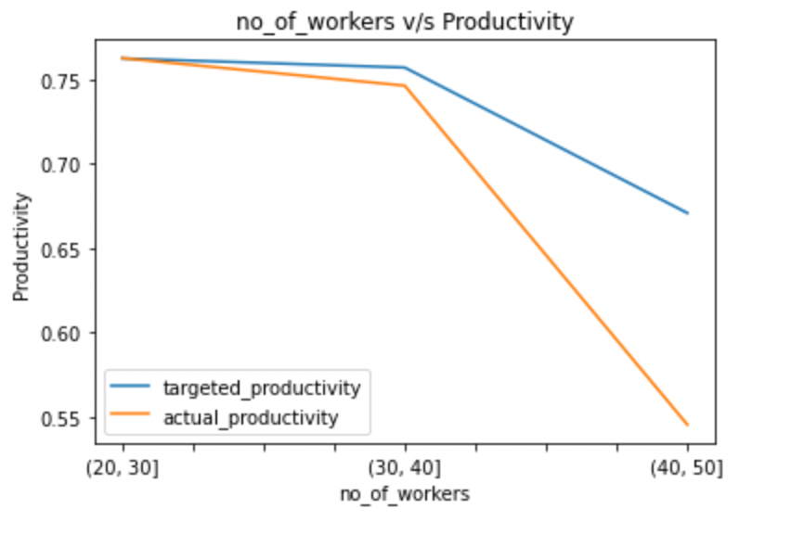
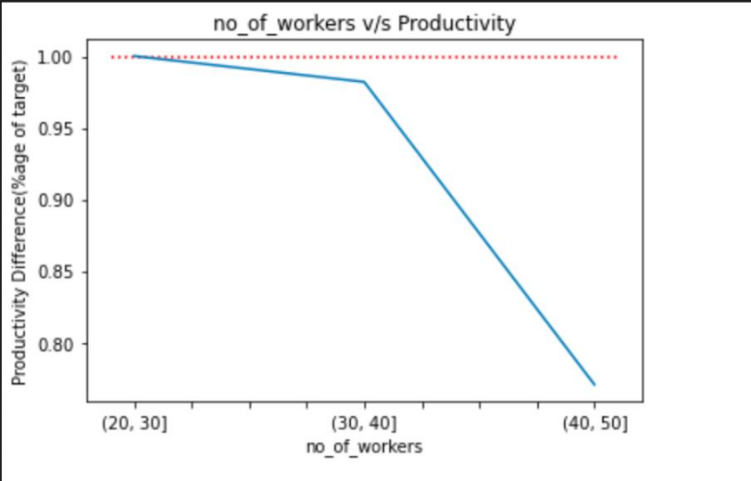
Optimum Team Size - Sewing
The sewing department favors mid-sized teams of 20-40 members. Team sizes greater than 40 see a stark deficit in meeting targeted productivity.

Slide 11
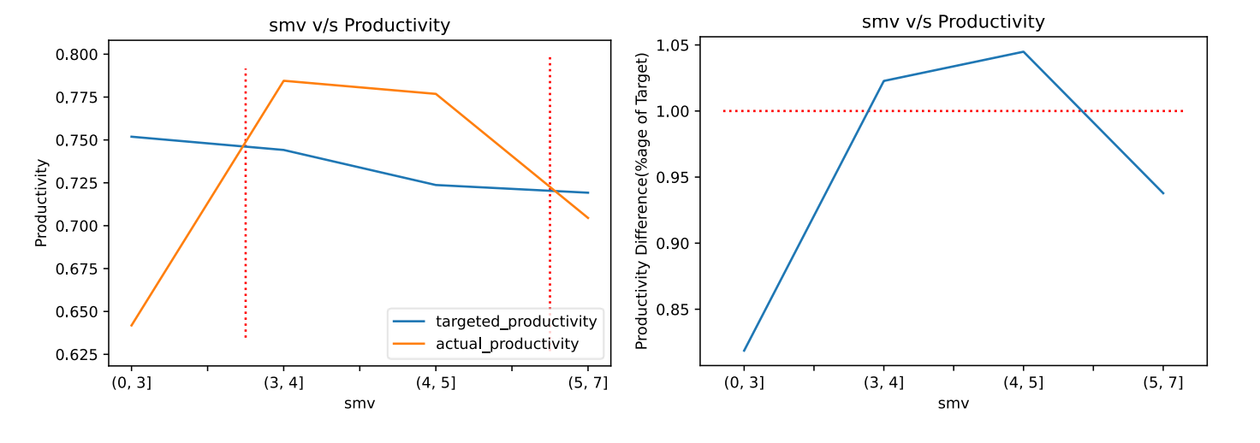
Team Task Complexity - Finishing
Task Complexity is derived from the standard minute value (smv) of the task. Greater SMV indicates a more complex task. The Finishing department typically has highest productivity when the task is medium complexity (ranges in between 3 to 6 SMV).

Slide 12
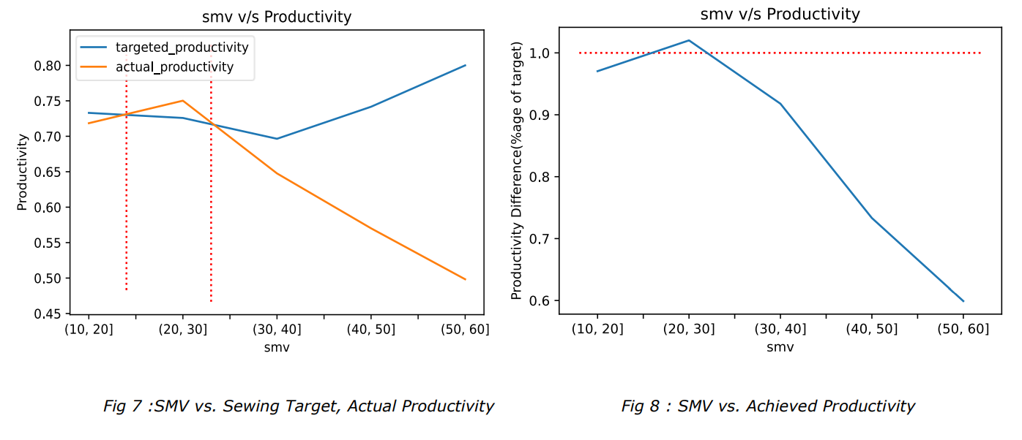
Team Task Complexity - Sewing
The Sewing department is most productive in tasks of low to medium complexity (ranges in between 23 to 33 SMV). As the complexity increases, we see a significant drop in productivity.
Note: Finishing jobs are typically less complex with mean smv of 3.8 and are largely independent. Compared to sewing jobs which are more specialized with mean smv of 24.2. As discussed in optimum team size, this proves that finishing jobs can be orchestrated in larger groups.

Slide 13
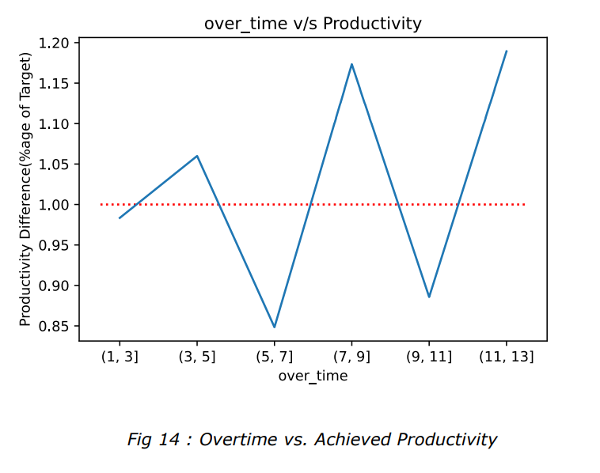
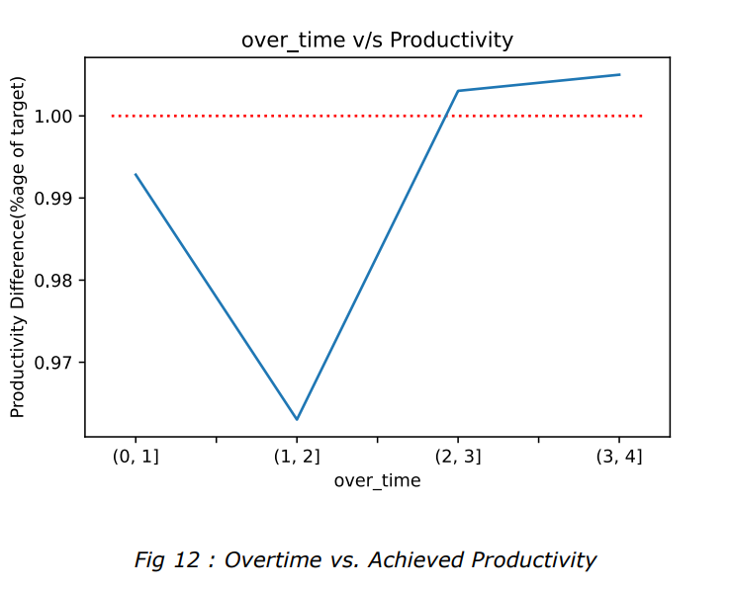
Overtime
Both, Finishing and Sewing tasks show no pattern between overtime and productivity. Sewing shows only a marginal increase in productivity, that too with over 3 hours per team member.

Slide 14
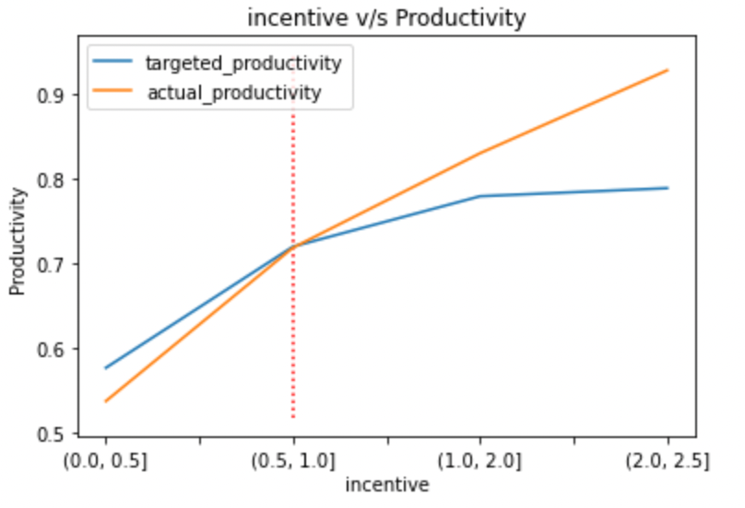
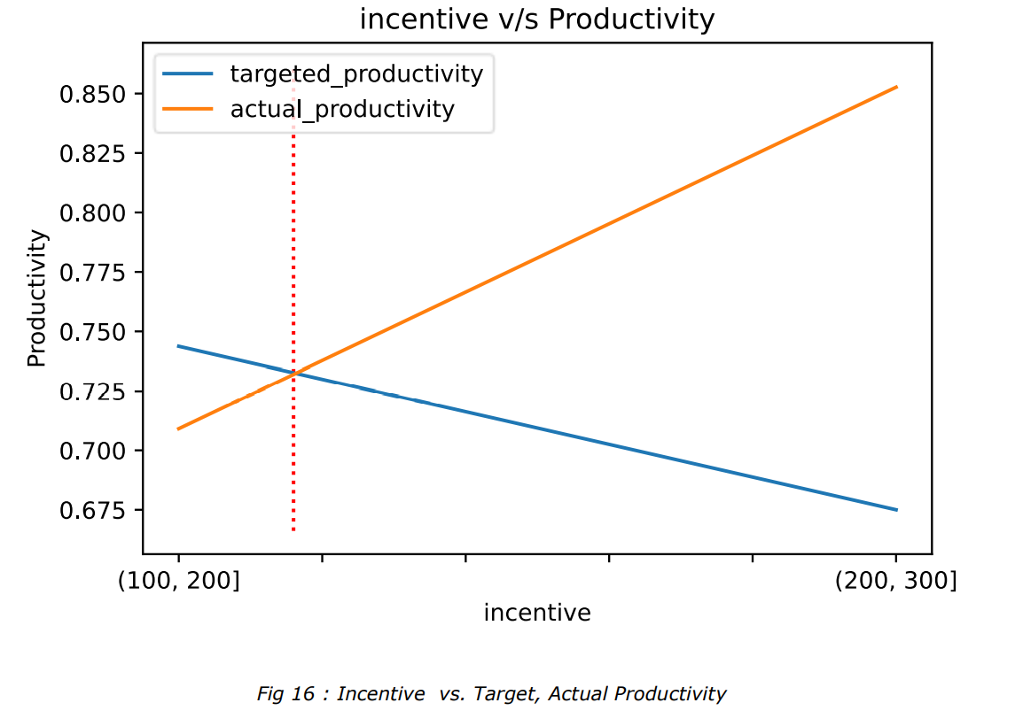
Incentives
Sewing department shows a high positive correlation between productivity and incentive (0.8). This is reflected in the increased productivity on weeks just before the incentive rollout. Finishing department does not receive much incentive to establish any significant relationship.

Slide 15
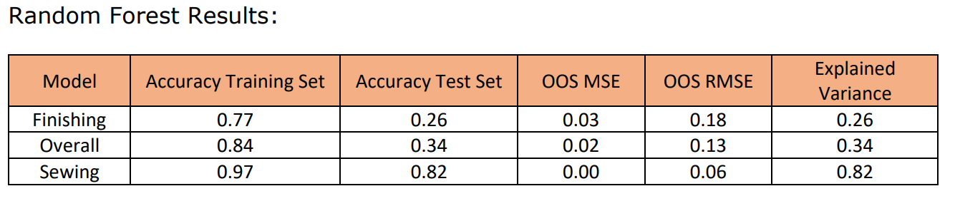
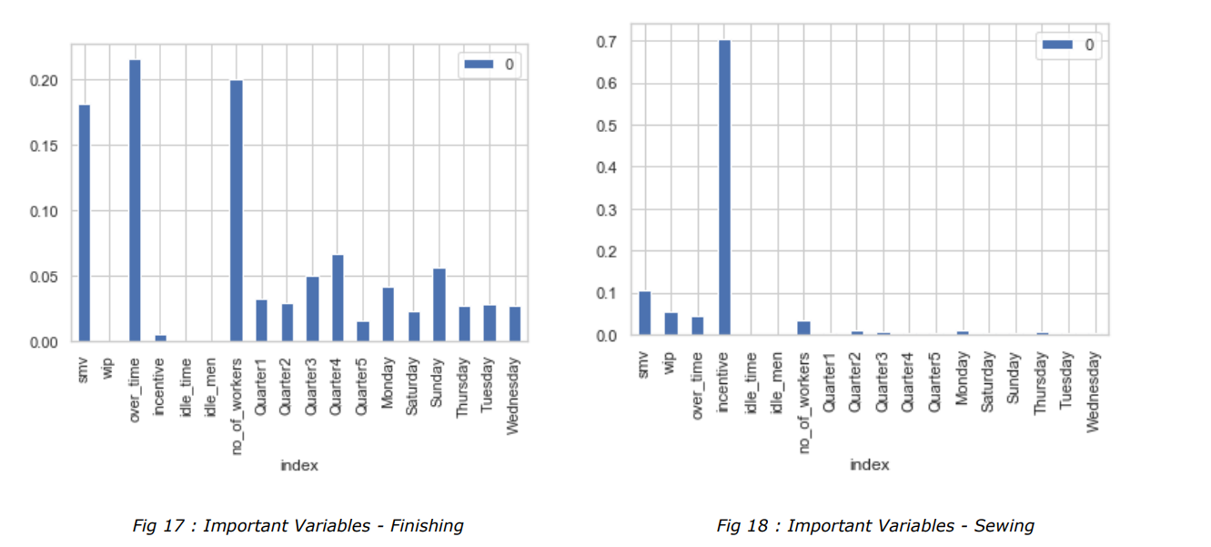
Random Forest Modelling
Based on our EDA, we leveraged a Random Forest model to predict productivity of a team and analyze the important variables that contribute to the prediction.

Slide 16
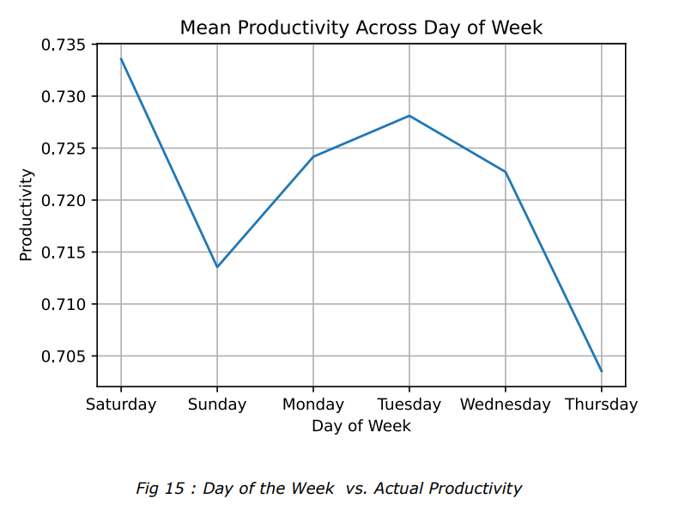
Overall Factory Level Analysis - Day of the Week
There are certain specific dips in productivity on Thursdays and Sundays. This dip occurs right before the day off for the employees and on days where most other offices are closed.

Slide 17
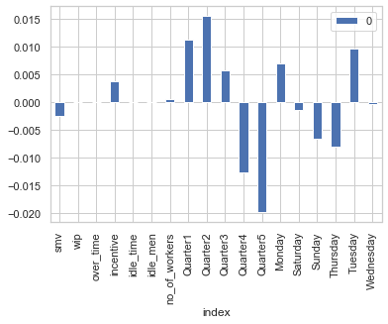
Multiple Linear Regression Modelling
The Multiple Linear Regression model re-confirms the hypothesis. It is observed that both Thursdays and Sundays do indeed have the largest negative coefficient causing dip in overall productivity of the factory.

Slide 18
Insights and Recommendations
1
2
3
Finishing and Sewing departments have different factors impacting productivity. Therefore, independent decision making is required for the department
In case of sewing, larger team size hampers productivity. While similar circumstances support productivity in Finishing. Therefore, we recommend reducing team size to 20-25 for Sewing and increasing to 18-20 for Finishing
For both departments, productivity is maximized for mid complexity tasks. We recommend breaking down the Sewing tasks to 23-33 SMV and Finishing tasks to 3-6 SMV

Slide 19
Insights and Recommendations
4
5
6
Higher overtime does not translate to increased productivity
Mid-month incentives are the most significant drivers of temporary increase in productivity. We recommend distributing incentives across weeks to improve consistency
Workers are least productive on Thursdays and Sundays

Slide 20
THANK YOU!
Any Questions?

